Slide 1
Transfer Learning with Neural Networks
Open Source for the Win
Presenter: Edward Preble Data Scientist, RTI International
DOG
CAT

Slide 2
Sooooo complicated…. do I REALLY need to care???
YES

Slide 3
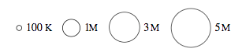
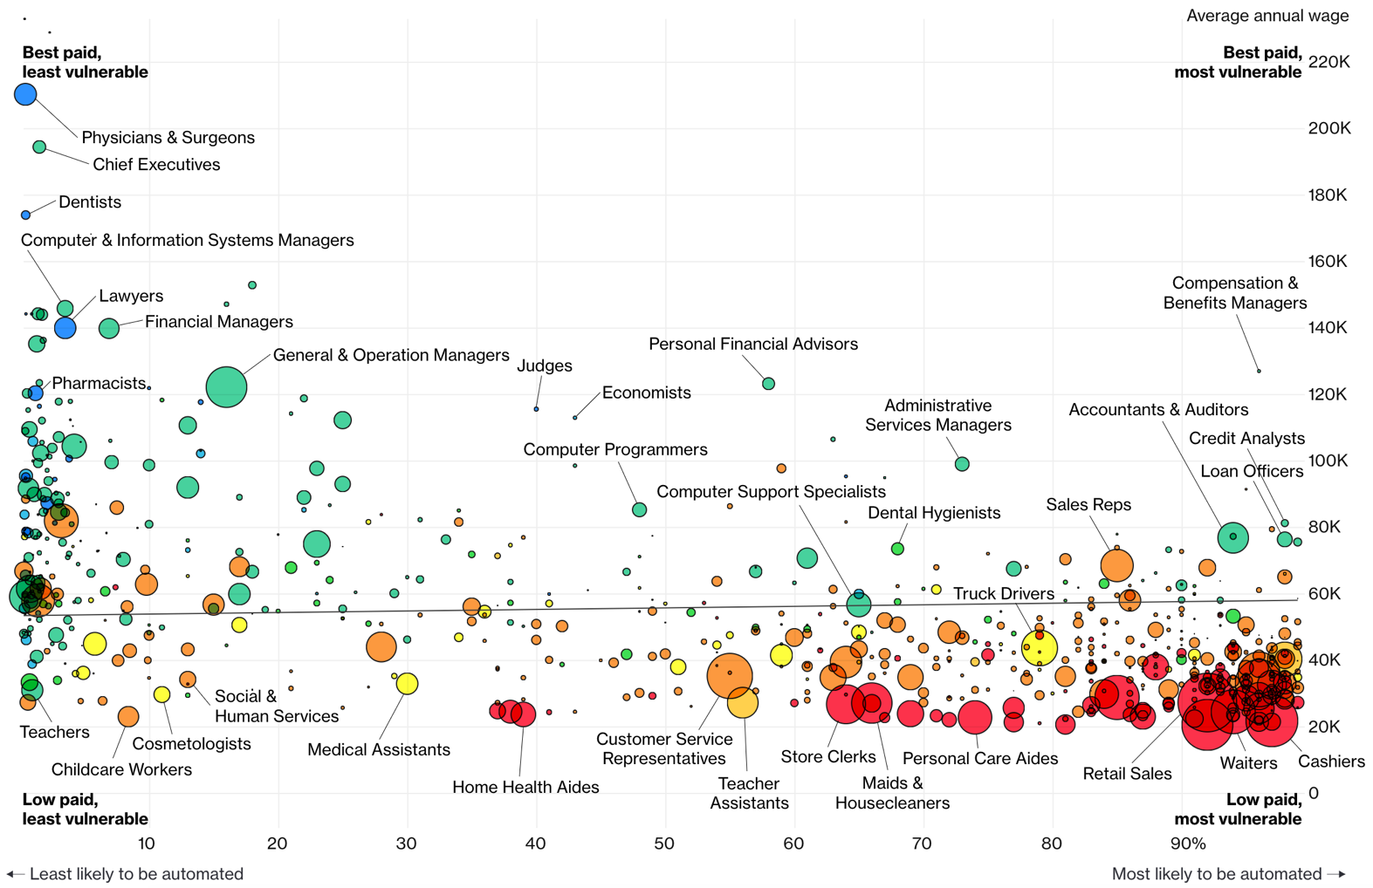
Jobs likely to be displaced by automation (esp. Neural Networks)
Bloomberg 7/2017

Slide 4
Lecture Agenda
Introduction
What is Transfer Learning?
Neural Network Basics
Use Case: Image Analysis
Use Case: Natural Language Processing (NLP)
Training data headaches
At 3:00 - Optional Session - Software Demo
Intro
Transfer Learning
Basics
Image Analysis
NLP
Training

Slide 5
Intro
Edward Preble, Senior Data Scientist at RTI International
github.com/epreble
IAA Class of 2017
Background:
Degrees in physics, materials science
Worked in semiconductor industry for 15 years
Prior to the IAA:
Little stats
No formal computer science (no python/R experience)
No exposure to deep learning
Intro
Transfer Learning
Basics
Image Analysis
NLP
Training

Slide 6
Why Lecture on Neural Networks?
Data Visualization / Data Manipulation Tech (Python + ?)
NASA – visualize International Space Station research output BERT, Dashboard
Police body-worn camera meta-data visualization SQL, Dashboard
Federal contract data visualization SQL, Dashboard
US Crime data pipeline Jupyter Notebooks
Fraud data processing SQL
Modeling Related
Seizure detection using ECG sensor Logistic, Basic Neural Networks
Financial risk simulation Monte Carlo Simulations
Custom object detection in drone videos Convolutional Neural Networks
Determine land use in Rwanda via satellite imagery Logistic
Determine physiological impact of lighting conditions Logistic
Drone route optimization for medical test kit delivery Optimization
Pre-symptomatic illness detection Kolmogorov-Smirnov Tests, XGBoost
Detect traumatic brain injury in ECG sensor data Logistic
Employee retention modeling Logistic
Biomass reactor modeling XGBoost
Opioid fatality leading indicator modeling BERT
Parolee risk score modeling Survival Analysis
Software Development
Aerosol penetration of protective clothing Real time image analysis
Business Related
Confidential Client – AI Research Reports
Confidential Client – Locate novel data sources for client needs Reports
20% of projects
used Neural
Networks
Intro
Transfer Learning
Basics
Image Analysis
NLP
Training

Slide 7
Lecture Agenda
Introduction
What is Transfer Learning?
Neural Network Basics
Use Case: Image Analysis
Use Case: Natural Language Processing (NLP)
Training data headaches
At 3:00 - Optional Session - Software Demo
Intro
Transfer Learning
Basics
Image Analysis
NLP
Training

Slide 8

What is Transfer Learning
Start with a model from a common use case that has lots of labeled data
Use that model on a less common use case that is closely related
Example:
Object detection in images
Intro
Transfer Learning
Basics
Image Analysis
NLP
Training

Slide 9
Why Not Make A Custom Model?
The best models required gargantuan resources to train
Google’s Inception Model (object detection)
Compute:
8 Nvidia Tesla K40s ($60,000 worth of GPUs)
2 weeks
Labeled Data (ImageNet, Prof. Fei-Fei Li @Stanford, now @Google)
14 million images
~22,000 categories (>500 images per category)
2.5 years using Amazon mechanical turk to label the first 25%
Intro
Transfer Learning
Basics
Image Analysis
NLP
Training

Slide 10
RTI Use Cases for Transfer Learning
1. Object detection in images
Model required: Locate mosquito breeding grounds in drone imagery
Doesn’t exist
Start with Google’s Inception model trained on ImageNet data
2. Text Classification
Model required: Is a news article relevant to the opioid epidemic?
Doesn’t exist
Start with Google’s BERT model trained on Wikipedia & BookCorpus
Intro
Transfer Learning
Basics
Image Analysis
NLP
Training

Slide 11
Q&A Pause
Questions?
Intro
Transfer Learning
Basics
Image Analysis
NLP
Training

Slide 12
Lecture Agenda
Introduction
What is Transfer Learning?
Neural Network Basics
Use Case: Image Analysis
Use Case: Natural Language Processing (NLP)
Training data headaches
At 3:00 - Optional Session - Software Demo
Intro
Transfer Learning
Basics
Image Analysis
NLP
Training

Slide 13
Neural Network Basics
All Image Pixels
Edges/Curves
Eyes/Nose
Dog
Input Data
Input Layers
Functions activate for simple features
Functions activate for complex features
Classification based on activations
Inception v3
(Google CNN Architecture)
Don’t stress about how complex this model looks. Transfer Learning will come to the rescue!
Intro
Transfer Learning
Basics
Image Analysis
NLP
Training

Slide 14
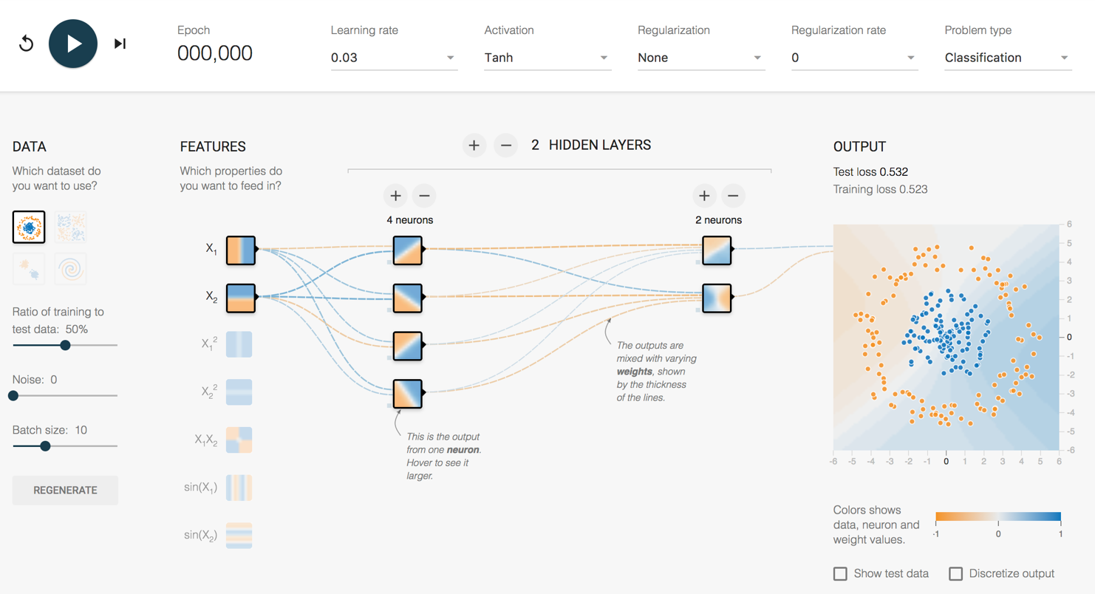
How does it work?
http://playground.tensorflow.org/
Intro
Transfer Learning
Basics
Image Analysis
NLP
Training

Slide 15
Q&A Pause
Questions?
Intro
Transfer Learning
Basics
Image Analysis
NLP
Training

Slide 16
How does a Convolutional Neural Network (CNN) “Learn”?
Backpropagation
Initial network settings are random
Test prediction using training data
Adjust network by a certain amount (Learning Rate) to reduce the error
Start at the end of the network and work backwards
?
Dog
Dog
Dog
?
Cat
Cat
Cat
?
?
Intro
Transfer Learning
Basics
Image Analysis
NLP
Training

Slide 17
How complex are these things?
All Image Pixels
Edges/Curves
Eyes/Nose
Dog
Input Data
Input Layers
Detection Filter
Simple Features
Detection Filter
Complex Features
Classification
Inception v3
(Google CNN Architecture)
Number of Parameters = 23,200,000
Number of Layers = 48
Intro
Transfer Learning
Basics
Image Analysis
NLP
Training

Slide 18
How long to train 23,200,000 parameters?
Intro
Transfer Learning
Basics
Image Analysis
NLP
Training

Slide 19
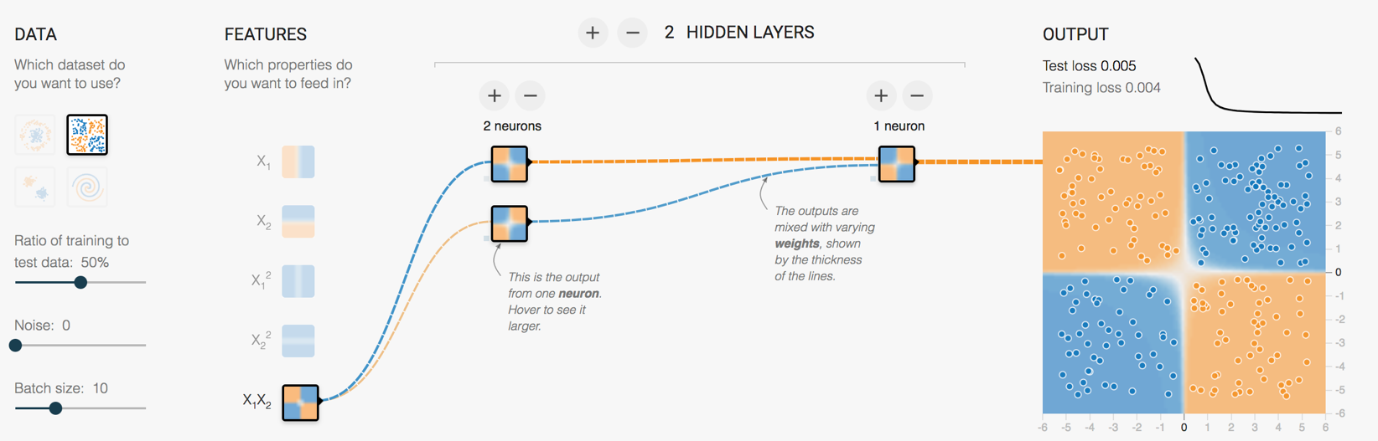
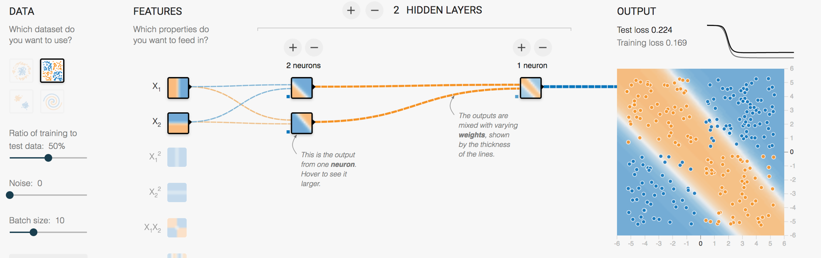
The key advance for our purposes
Retraining the last layer is all that is needed for basic human recognizable objects
ImageNet trained weights for Inception v3 are downloadable
Intro
Transfer Learning
Basics
Image Analysis
NLP
Training

Slide 20
Where are we today
Computational platform → Tensorflow
Model architecture → Inception_v3 structure
ImageNet pre-trained weights
Python scripts to handle the retraining
Intro
Transfer Learning
Basics
Image Analysis
NLP
Training

Slide 21
Software Demo – 3pm
Demo Plan:
Review Tensorflow for Poets Demo
Retrain Inception for flower classification
Run Person Classification Demo
Retrain Inception to recognize my family
Intro
Transfer Learning
Basics
Image Analysis
NLP
Training

Slide 22
Q&A Pause
Questions?
Intro
Transfer Learning
Basics
Image Analysis
NLP
Training

Slide 23
Lecture Agenda
Introduction
What is Transfer Learning?
Neural Network Basics
Use Case: Image Analysis
Use Case: Natural Language Processing (NLP)
Training data headaches
At 3:00 - Optional Session - Software Demo
Intro
Transfer Learning
Basics
Image Analysis
NLP
Training

Slide 24
How can CNN’s automate jobs?
CNN’s are enabling a big leap for sensory data processing (auditory, visual, IoT sensors)
Image Recognition Accuracy
Intro
Transfer Learning
Basics
Image Analysis
NLP
Training

Slide 25
Existing Applications of Object Detection
Autonomous driving – All driving context objects
Manufacturing – Anomaly detection for quality control
Face recognition – Customer or friend identification
People counting – Store visitors or crowd size estimation
Online image censoring – Nudity, violence, contraband
Security – Automated detection of weapons, intruders
Intro
Transfer Learning
Basics
Image Analysis
NLP
Training

Slide 26
Things that CNNs can do really well
Classification
& Localization
Instance
Segmentation
Classification
Object Detection
Demo @3p
RTI Use Case
Intro
Transfer Learning
Basics
Image Analysis
NLP
Training

Slide 27
Object Detection – RTI Use Case
Mosquito breeding site identification in Guatemala
Existing Solution
Walking teams
Desired Solution
Target map assists walking team
Intro
Transfer Learning
Basics
Image Analysis
NLP
Training

Slide 28
Object Detection Transfer Learning
Use an already trained object detector
Why not training a sophisticated/dedicated object detector from scratch?
Not enough labeled training data (few hundred labeled images)
High cost (GPU time, labor)
Months of life
Augment the data with our new use case
Labeled images of tires, water cisterns
“Retrain” part of the model with our new information
We have transferred the previous learning to our use case!
Intro
Transfer Learning
Basics
Image Analysis
NLP
Training

Slide 29
Q&A Pause
Questions?
Intro
Transfer Learning
Basics
Image Analysis
NLP
Training

Slide 30
Lecture Agenda
Introduction
What is Transfer Learning?
Neural Network Basics
Use Case: Image Analysis
Use Case: Natural Language Processing (NLP)
Training data headaches
At 3:00 - Optional Session - Software Demo
Intro
Transfer Learning
Basics
Image Analysis
NLP
Training

Slide 31
Natural Language Processing (NLP)
The transfer learning revolution has recently arrived for text
Language Transformers
BERT (Google, Bidirectional Encoder Representations from Transformers)
XLNet (Google)
RoBERTa (Facebook)
GPT-3 (OpenAI, Generative Pre-Training)
MT-DNN (Microsoft, Multi-Task Deep Neural Networks)
Transformer (Hugging Face)
Intro
Transfer Learning
Basics
Image Analysis
NLP
Training

Slide 32
How do Language Transformers work?
Trained on huge text libraries (e.g. Wikipedia, Reddit, BooksCorpus etc)
Transformers endeavor to predict words based on context
The window for what constitutes “context” is unlimited
BERT looks forward and backward during training
Bidirectional Encoder Representations from Transformers
Intro
Transfer Learning
Basics
Image Analysis
NLP
Training

Slide 33
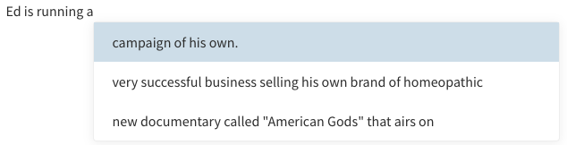
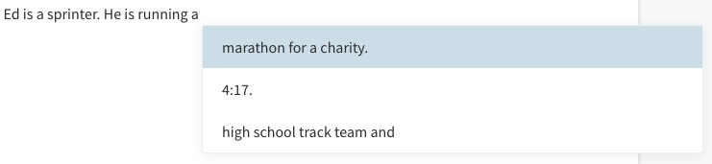
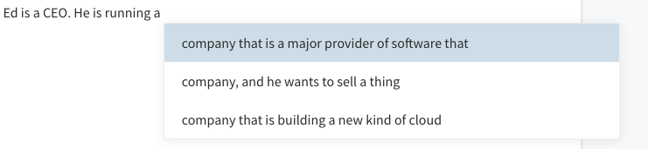
Text Prediction Examples (https://transformer.huggingface.co/doc/gpt2-large)

Slide 34
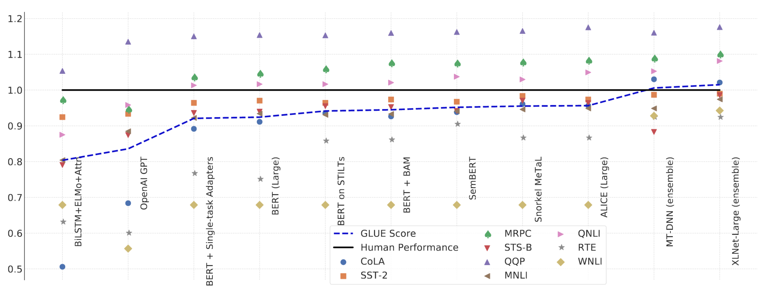
How can Language Transformers automate jobs?
Just like CNNs, Language Transformers are now exceeding Human Performance on some tasks
Source: Wang et al. (2019)
Intro
Transfer Learning
Basics
Image Analysis
NLP
Training

Slide 35
Text Classification Use Case
Understanding the local trends of opioid related fatalities in the US
Problem: Opioid related fatality data isn’t published for 12-18 months
Solution: Need real-time indicators of opioid related trends
Data sources:
Twitter
News Articles
EMS (Ambulance) data
Intro
Transfer Learning
Basics
Image Analysis
NLP
Training

Slide 36
Is a news article relevant?
In the US, approx. 2,000 news articles/day mention opioids
Too many to manually classify (cheaply)
Spent 12 months classifying 3hrs of articles a week
Generated 16,000 articles for training data
15,000 not relevant
1,000 relevant
Trained a BERT classifier
Accuracy of “Relevant” prediction: 86%
Accuracy of “Not-Relevant” prediction: 97%
Intro
Transfer Learning
Basics
Image Analysis
NLP
Training

Slide 37

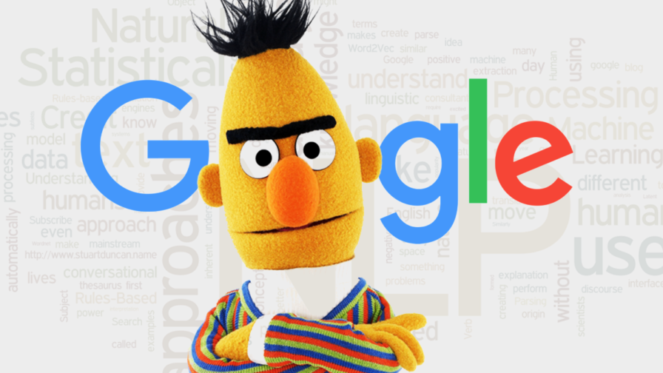
Scorecard
Articles / Week
Relevant
Scope
300
14,000
19
875
4 States
Entire US
Intro
Transfer Learning
Basics
Image Analysis
NLP
Training

Slide 38
Ethics Sidebar
Did I just take away someone’s job?
No
RTI changed the job
10% Manual coding still done quarterly for quality checks
90% Leveraging higher volume data to evaluate opioid policy research
Will it always go like that?
No. It won’t. Have that discussion!
Upskilling the job should always be preferred to eliminating it
Intro
Transfer Learning
Basics
Image Analysis
NLP
Training

Slide 39
Q&A Pause
Questions?
Intro
Transfer Learning
Basics
Image Analysis
NLP
Training

Slide 40
Lecture Agenda
Introduction
What is Transfer Learning?
Neural Network Basics
Use Case: Image Analysis
Use Case: Natural Language Processing (NLP)
Training data headaches
At 3:00 - Optional Session - Software Demo
Intro
Transfer Learning
Basics
Image Analysis
NLP
Training

Slide 41
Labeling Training Data
Can be VERY time consuming
Data science 80/20 rule
Object Detection Requires:
Images
Categories & boxes coordinates
Text Classification Requires:
Class labels, often nuanced
Keyword searches not enough
Image1, Cat, x/y coordinates
Intro
Transfer Learning
Basics
Image Analysis
NLP
Training

Slide 42
Real world images can be very busy
Intro
Transfer Learning
Basics
Image Analysis
NLP
Training

Slide 43
Faster ways to get more already-labeled data
For images, use video instead of stills
Not as varied (bad)
Generates thousands of images easily (very very good)
I’ll show image extraction during the demo
If time, I’ll also show an object tracking demo to get bounding boxes
For text, use reverse translations
Once text is labelled, translate it to different languages and back
Intro
Transfer Learning
Basics
Image Analysis
NLP
Training

Slide 44
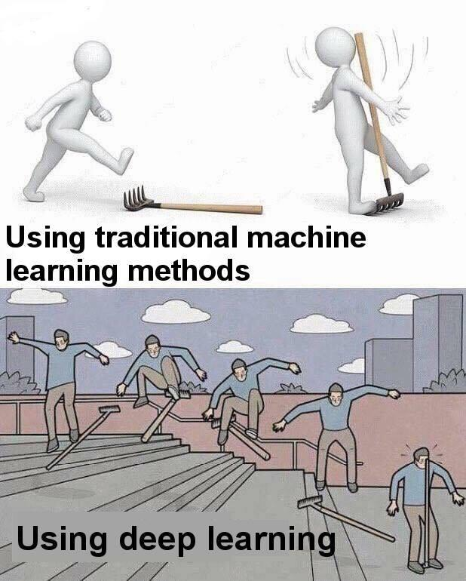
Sometimes Simple is Better
Hmmm… Logistic Didn’t Work?!?
Deep Learning is awesome,
maybe that will work?
Intro
Transfer Learning
Basics
Image Analysis
NLP
Training

Slide 45
Resources to Learn More
Entry Level Videos:
Josh Gordon (Google) Python Machine Learning Tutorials https://www.youtube.com/watch?v=cKxRvEZd3Mw
Siraj Raval - Various Artificial Intelligence Videos https://www.youtube.com/channel/UCWN3xxRkmTPmbKwht9FuE5A
More Advanced
Adrian Rosebrock (Lots of Python and OpenCV Materials) https://www.pyimagesearch.com/
Intro
Transfer Learning
Basics
Image Analysis
NLP
Training

Slide 46
Thanks!
Break Time! Optional demo next
Three goals:
Use video to create training data
Review Tensorflow for Poets
Train an Inception v3 model to recognize my family
Get 200+ training images quickly using video
Train the model and test it!

